Slide 1
EI
Atender Rostros |  |  |  |  | Ignorar Rostros
 | AIC | F | r-ajustada | p |  | AIC | F | r-ajustada | p
value ~ EDAD + MoCA + CRI_Total + EDAD:CRI_Total + MoCA:CRI_Total | 639.12 | 7.101 | 0.1284 | 3.85E-06 | value ~ EDAD * ESCOLARIDAD * MoCA * CRI_Total | 516.77 | 5.653 | 0.2521 | 1.59E-09
 | β |  | t | p |  | β |  | t | p
(Intercept) | 156.993636 |  | 2.716 | 0.00717 | (Intercept) | -2.39E+03 |  | -2.409 | 0.01694
EDAD | -0.232926 |  | -1.385 | 0.16762 | EDAD | 4.53E+01 |  | 2.526 | 0.01235
 |  |  |  |  | ESCOLARIDAD | 1.76E+02 |  | 3.098 | 0.00224
MoCA | -4.532997 |  | -2.294 | 0.02281 | MoCA | 8.37E+01 |  | 2.33 | 0.02087
CRI_Total | -1.195784 |  | -2.332 | 0.02067 | CRI_Total | 1.70E+01 |  | 1.848 | 0.0662
 |  |  |  |  | EDAD:ESCOLARIDAD | -3.27E+00 |  | -3.182 | 0.0017
 |  |  |  |  | EDAD:MoCA | -1.57E+00 |  | -2.419 | 0.01649
 |  |  |  |  | ESCOLARIDAD:MoCA | -6.16E+00 |  | -2.999 | 0.00307
EDAD:CRI_Total | 0.003327 |  | 2.161 | 0.03184 | EDAD:CRI_Total | -3.23E-01 |  | -1.991 | 0.04785
 |  |  |  |  | ESCOLARIDAD:CRI_Total | -1.30E+00 |  | -2.532 | 0.01214
MoCA:CRI_Total | 0.034965 |  | 2.004 | 0.04643 | MoCA:CRI_Total | -5.87E-01 |  | -1.757 | 0.08056
 |  |  |  |  | EDAD:ESCOLARIDAD:MoCA | 1.14E-01 |  | 3.067 | 0.00248
 |  |  |  |  | EDAD:ESCOLARIDAD:CRI_Total | 2.43E-02 |  | 2.677 | 0.00808
 |  |  |  |  | EDAD:MoCA:CRI_Total | 1.12E-02 |  | 1.894 | 0.05979
 |  |  |  |  | ESCOLARIDAD:MoCA:CRI_Total | 4.54E-02 |  | 2.429 | 0.01605
 |  |  |  |  | EDAD:ESCOLARIDAD:MoCA:CRI_Total | -8.48E-04 |  | -2.564 | 0.01113

Slide 2
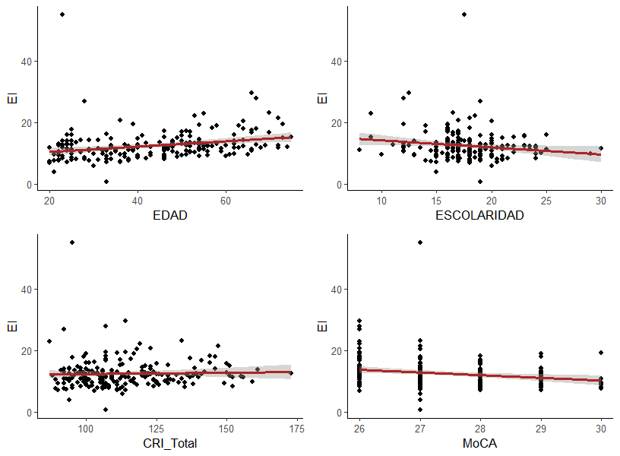
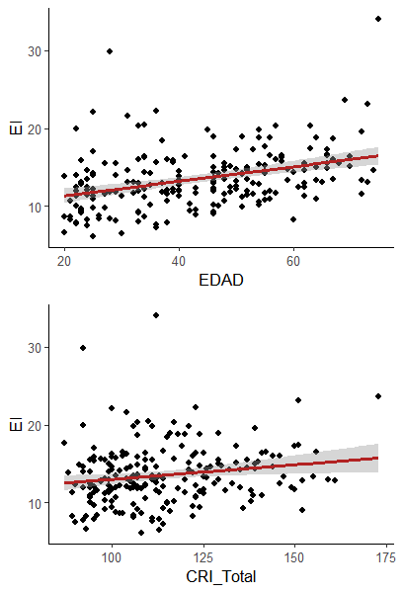
ATENDER ROSTROS
IGNORAR ROSTROS
ÍNDICE DE EFICIENCIA INVERSA
ATENDER | β | p | IGNORAR | β | p
EDAD | -0.232926 | 0.16762 | EDAD | 4.53E+01 | 0.01235
CRI_Total | -1.195784 | 0.02067 | CRI_Total | 1.70E+01 | 0.0662

Slide 3
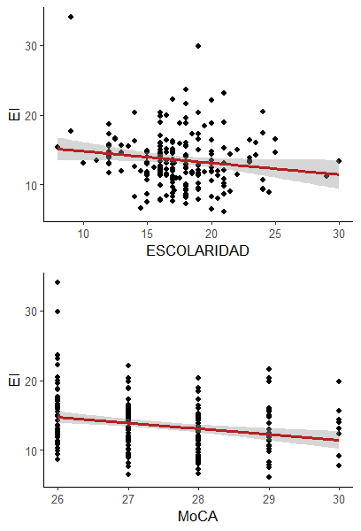
ATENDER ROSTROS
IGNORAR ROSTROS
ÍNDICE DE EFICIENCIA INVERSA
ATENDER | β | P | IGNORAR | β | p
ESCOLARIDAD |  |  | ESCOLARIDAD | 1.76E+02 | 0.00224
MoCA | -4.532997 | 0.02281 | MoCA | 8.37E+01 | 0.02087

Slide 4
ÍNDICES ATENCIONALES
ÍNDICE DE AMPLIFICACIÓN |  |  |  |  | ÍNDICE DE SUPRESIÓN
 | AIC | F | r-ajustada | p |  | AIC | F | r-ajustada | p
value ~ ESCOLARIDAD + MoCA + ESCOLARIDAD:MoCA | 2471.94 | 3.636 | 0.0368 | 0.01376 | value ~ EDAD + CRI_Total + EDAD:CRI_Total | 2518.52 | 2.428 | 0.02028 | 0.06654
 | β |  | t | p |  | β |  | t | p
(Intercept) | 6656.664 |  | 1.912 | 0.0573 | (Intercept) | 1673.6934 |  | 2.232 | 0.0267
 |  |  |  |  | EDAD | -34.6121 |  | -2.438 | 0.0156
ESCOLARIDAD | -423.013 |  | -2.122 | 0.035
MoCA | -251.288 |  | -1.966 | 0.0506
 |  |  |  |  | CRI_Total | -13.1117 |  | -1.818 | 0.0706
ESCOLARIDAD:MoCA | 16.175 |  | 2.211 | 0.0281
 |  |  |  |  | EDAD:CRI_Total | 0.2844 |  | 2.188 | 0.0298

Slide 5
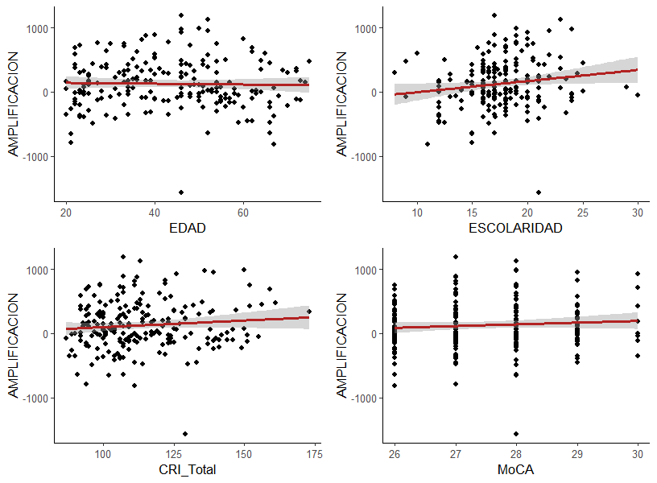
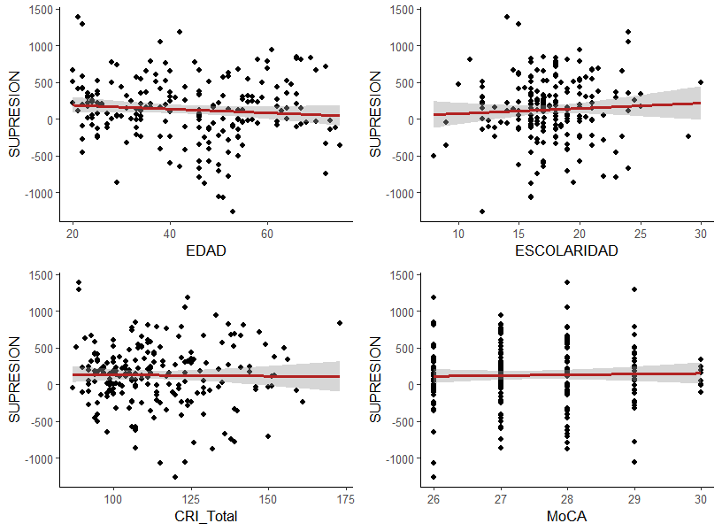
ÍNDICES ATENCIONALES
AMPLIFICACION | β | p | SUPRESION | β | p
EDAD |  |  | EDAD | -34.6121 | 0.0156
CRI_Total |  |  | CRI_Total | -13.1117 | 0.0706

Slide 6
ÍNDICES ATENCIONALES
AMPLIFICACION | β | p | SUPRESION | β | p
ESCOLARIDAD | -423.013 | 0.035 | ESCOLARIDAD
MoCA | -251.288 | 0.0506 | MoCA

Slide 7
D PRIMA
Atender Rostros |  |  |  |  | Ignorar Rostros
 | AIC | F | r-ajustada | p |  | AIC | F | r-ajustada | p
value ~ EDAD + MoCA + CRI_Total + EDAD:MoCA + MoCA:CRI_Total | -343.23 | 5.948 | 0.1068 | 3.73E-05 | value ~ EDAD * ESCOLARIDAD * MoCA * CRI_Total | -329.92 | 2.912 | 0.1217 | 3.61E-04
 | β |  | t | p |  | β |  | t | p
(Intercept) | -6.083819 |  | -1.261 | 0.2088 | (Intercept) | 2.56E+02 |  | 1.973 | 0.0499
EDAD | -0.124 |  | -1.885 | 0.0609 | EDAD | -4.955 |  | -2.116 | 0.03565
 |  |  |  |  | ESCOLARIDAD | -1.77E+01 |  | -2.387 | 0.01796
MoCA | 0.339838 |  | 1.921 | 0.0561 | MoCA | -8.863 |  | -1.889 | 0.06044
CRI_Total | -0.110826 |  | 2.047 | 0.042 | CRI_Total | -1.803 |  | -1.502 | 0.13472
 |  |  |  |  | EDAD:ESCOLARIDAD | 3.49E-01 |  | 2.603 | 0.00998
EDAD:MoCA | 0.004229 |  | 1.752 | 0.0812 | EDAD:MoCA | 1.74E-01 |  | 2.043 | 0.04237
 |  |  |  |  | ESCOLARIDAD:MoCA | 6.23E-01 |  | 2.322 | 0.02131
 |  |  |  |  | EDAD:CRI_Total | 3.55E-02 |  | 1.673 | 0.09587
 |  |  |  |  | ESCOLARIDAD:CRI_Total | 1.28E-01 |  | 1.909 | 0.05777
MoCA:CRI_Total | -0.003953 |  | -1.985 | 0.0485 | MoCA:CRI_Total | 6.28E-02 |  | 1.439 | 0.15187
 |  |  |  |  | EDAD:ESCOLARIDAD:MoCA | -1.23E-02 |  | -2.516 | 0.01269
 |  |  |  |  | EDAD:ESCOLARIDAD:CRI_Total | -2.52E-03 |  | -2.129 | 0.03453
 |  |  |  |  | EDAD:MoCA:CRI_Total | -1.24E-03 |  | -1.601 | 0.11095
 |  |  |  |  | ESCOLARIDAD:MoCA:CRI_Total | -4.49E-03 |  | -1.838 | 0.06756
 |  |  |  |  | EDAD:ESCOLARIDAD:MoCA:CRI_Total | 8.82E-05 |  | 2.042 | 0.04257

Slide 8
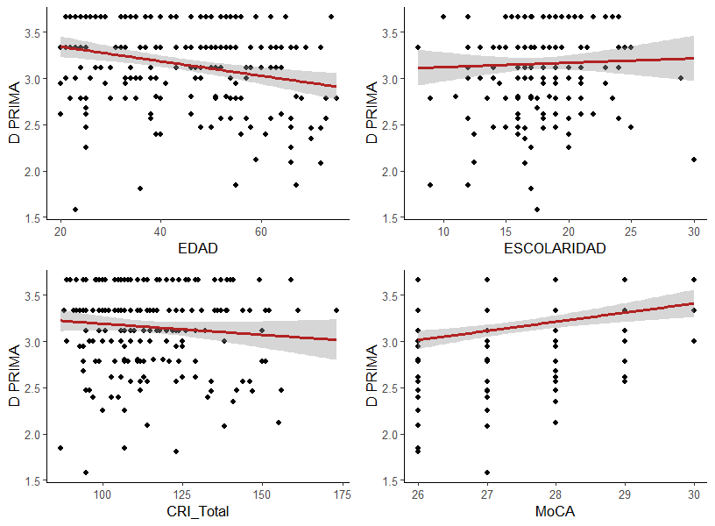
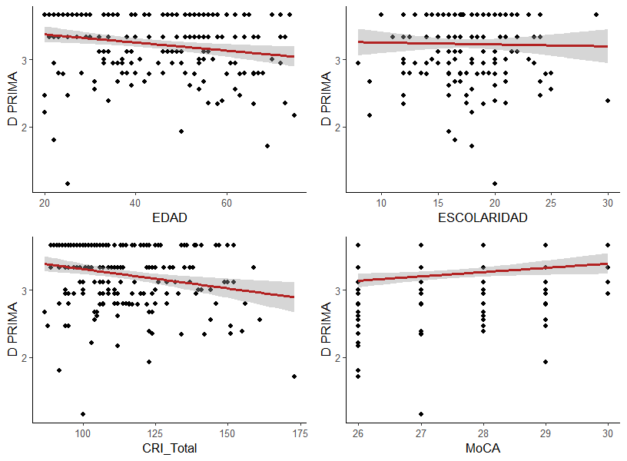
ATENDER ROSTROS
IGNORAR ROSTROS
EFICIENCIA MEMORIA DE TRABAJO
ATENDER | β | p | IGNORAR | β | p
EDAD | -0.124 | 0.0609 | EDAD | -4.955 | 0.03565
CRI_Total | -0.110826 | 0.042 | CRI_Total | -1.803 | 0.13472

Slide 9
ATENDER ROSTROS
IGNORAR ROSTROS
EFICIENCIA MEMORIA DE TRABAJO
ATENDER | β | p | IGNORAR | β | p
ESCOLARIDAD |  |  | ESCOLARIDAD | -17.67 | 0.01796
MoCA | 0.339838 | 0.0561 | MoCA | -8.863 | 0.06044

